Slide 1


Slide 2
About Us
OUR MISSION: To deliver health and hope using donated flights to serve people with healthcare or other compelling human needs.
In the air, ANGEL FLIGHT WEST links volunteer pilots and commercial airline partners with people whose non-emergency health needs require air transportation to access care. On the ground, volunteer drivers ferry passengers to and from their departure and destination airports.
38+ YRS
DEDICATED
SERVICE
94,000+
DONATED
FLIGHTS
$0
PATIENT
COST
1,800+
VOLUNTEER
PILOTS

Slide 3
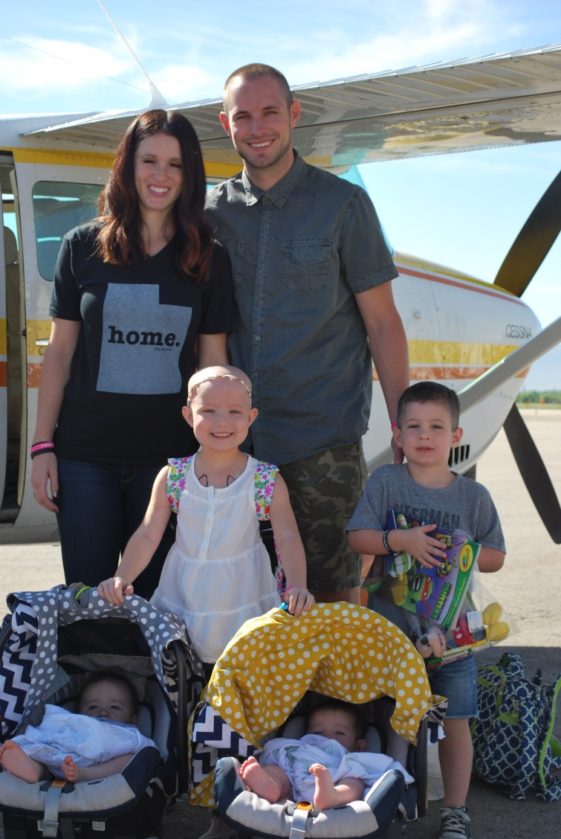
Who We Serve
Patients traveling for non-emergency care at major research hospitals, children’s hospitals, specialized treatment centers and more.
Kids attending specialty camps, such as those for young burn survivors or cancer patients.
Survivors of domestic violence in need of relocation.
Veterans and active-duty military personnel.
Disaster relief efforts.
Blood for non-profit blood banks.
People with other compelling human needs.

Slide 4
Passenger Qualifications
PASSENGERS MUST . . .
Be medically stable and ambulatory.
Be capable of sitting upright wearing safety belt for duration of flight.
Have a scheduled appointment with a minimum of one-week notice.
Have a financial need or other compelling consideration (i.e. immune compromised, geography, etc.).
Traveling a distance less than 1,000 nautical miles.
If flying privately, be able to fly in a small unpressurized aircraft.

Slide 5
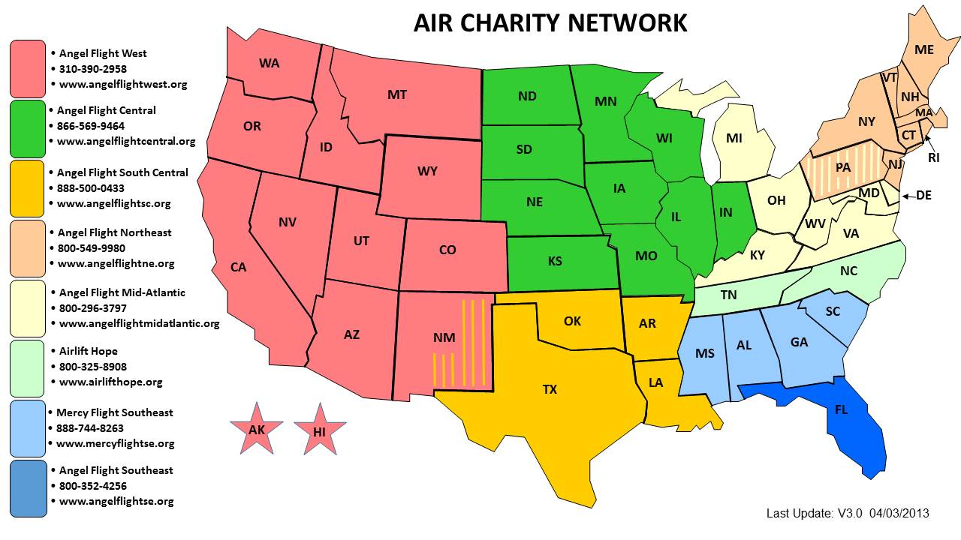
Where We Fly
Toll Free – Request routed by area code of the caller
(877) 621-7177
www.aircharitynetwork.org

Slide 6
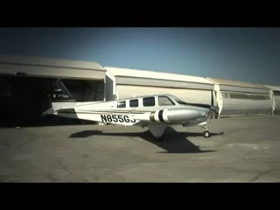
Types of Flights
Pre-Flight Planner
Volunteer Pilots
Primarily small, single-engine aircraft
Typically 4-6 seats on average
Piloted by AFW volunteers
Limited to 900 mile flights
  If passenger is traveling more 300 miles, flight split into 2- or 3-leg relays, with a different pilot flying each segment

Slide 7





Types of Flights
Alaska Airlines & other Airline Partners
Donated commercial tickets
For passengers in Alaska and Hawai’i and…
Possible backup option if no pilot is available or if weather conditions keep our pilots grounded
Compassion flights at AFW discretion using donated miles

Slide 8
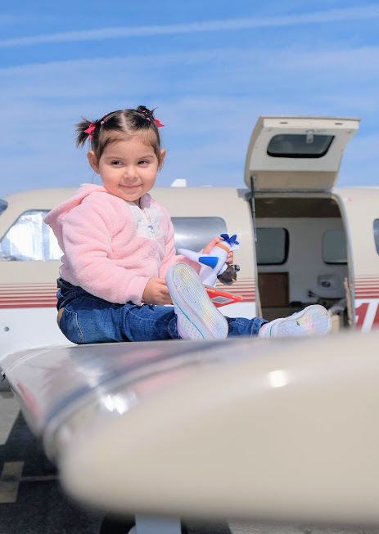
Requesting a Flight
  Request at www.angelflightwest.org or by calling (310) 390-2958.
  Initial request can come directly from passenger or medical/social work professional.
  Repeat passengers can request additional flights directly after initial flight.

Slide 9
Guide to Medical Transportation
For healthcare professionals
Free, online, self-paced, NASW accredited CME course for social workers, brought to you by Angel Flight West.
According to Health Outreach Partners, transportation is the #2 barrier to healthcare in the US, second only to cost. In this course, you will learn about a variety of transportation options for your patients who need to travel for medical treatment The course will enable you to better serve patients who need to travel for diagnosis and treatment of rare diseases, cancer, second opinions, specialized surgery, pediatric care, and other chronic conditions.
Register for free any time at cme.angelflightwest.org.
Accredited by the NASW for 1.5 CME hours. Accreditation pending in Oregon and Idaho.

Slide 10
Contacts
For more information about Angel Flight West
please visit our website:
www.AngelFlightWest.org
(310) 390-2958
info@angelflightwest.org
Ivan Martinez, Director of Outreach
(310) 390-2958 ext.115
IvanM@angelflightwest.org

